Slide 1
CP4P *
Problem Solving
Computer Principles for Programmers

Slide 2
Why Problem Solving?
Programming is hard.
  If it was easy, no one would pay us to do it.
Learning is hard.
  If it was easy, it would be called doing.
So, learning to program is doubly hard.
  We're going to be wrong a lot through this process.
Notes:
There have always been colleges and universities in one form or other as places where we help each other do difficult things.
Although we are here to learn about technology, the teaching and learning itself is not about technology.
What technology is being referred to in this statement:
“What will create forgetfulness...because they will not use their memories?“
…come on, what have you heard your parents, grandparents, and grey haired people (like me) say?
[the internet, smart phones, Wikipedia, etc]
It was Socrates in 370BCE who said, “Writing will create forgetfulness...because they will not use their memories.“ Ironically, Plato wrote it down for him in The Phaedrus.
Since then, every new form of technology has predicted doom for education in colleges and universities.
Gutenberg’s printing press caused quite a stir. People will no longer need to go to church or college – they will stay home and read for themselves. But how will they interpret what they read?
Radio was going to replace the classroom and the concert hall.
The telephone (and later the fax machine) would replace the office.
Television was going to replace the cinema, the theatre, and the classroom.
Computer based training would replace teachers.
The Internet would replace…everything.
So why classes and labs? Because face-to-face is the best interface. We get together to help each other do difficult things. Our objective is to learn problem-solving skills, discover new ways to think, and to look at the world differently.

Slide 3
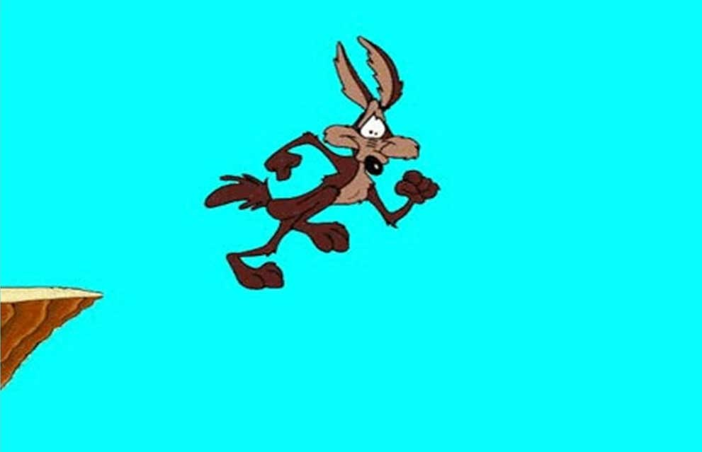
Programming: things to get used to
How does it feel to be wrong?
Being wrong feels like being right…
until you realize you’re wrong, like Wile E. Coyote
An expert is a man who has made all the mistakes
which can be made in a very narrow field. – Niels Bohr
Good judgement comes from experience,
and experience comes from bad judgement.
Notes:
Tell me, what does it feel like to be wrong? Demoralizing, embarrassing, dreadful. Actually, they are answers to a different question which is “What does it feel like to realize you are wrong?” Then it is “demoralizing, embarrassing, and dreadful.” So, what does it feel like when you’re wrong? [click] Wile E. Coyote can run and stand in mid-air as long as he thinks there is ground beneath his feet. It is only when he goes from feeling right to feeling wrong that he falls.
Learning in primary and secondary school has often meant getting the right answer and discovering that the way to succeed in life is not to make any mistakes. Sadly, when learning to program, we make a lot of mistakes and get a lot of wrong answers. The editor corrects your typing. The compiler complains about your syntax. The program crashes or loops infinitely. The test case fails. Things are wrong until they are right…and then you’re done. On to the next project where we will be wrong again for 99% of the time.
Yet, there is only so much of being wrong anyone can take. We know human nature is fallible. But we don’t like the experience personally.
[ click ]
We need reasons to explain all this wrongness. When my smartphone misbehaves, I blame the network, Android, and the programmer who worked hard to make that free app for me. As programmers, we will all blame the compiler at least once in our lives.
"You can't go wrong being wrong." "Errors are how our assumptions become visible. And there is little more valuable than a newly-discovered assumption, because only then can you see what's holding you back and what could propel you forward." see http://www.hyperorg.com/backissues/joho-apr30-99.html#wrong
How many times have we struggled into the wee hours of the morning—just one more compile—given up, and realized the solution to the problem when taking a shower the next morning?
Being wrong is not some kind of embarrassing defect in the human system, it's fundamental to who we are; it is the source and root of all of our productivity and creativity. (Schultz, 2010)
"failure is the essence of programming" – Chris Szalwinski

Slide 4
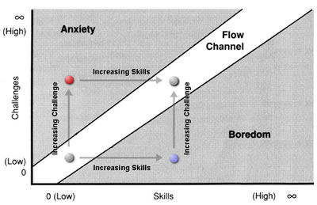
How do experts get to be experts
... without giving up?
Flow,
Mihaly Csikszentmihalyi, 1990
[ mee-HIGH
CHEEK-sent-mee-HIGH-e ]
Notes:
How do experts get to be experts without giving up? They are good at staying within the Flow Channel. They can tolerate some anxiety because of their confidence in learning new skills to meet the challenge. They fix their boredom by finding new challenges.
Teachers, who are very comfortable with their subject matter, can often find themselves in a high state of flow when in the classroom. A teacher is in a state of flow when a student asks for a desperately needed break. Marking, on the other hand, is usually below teachers' flow channel in the boredom region. An old professor said he taught for free but was paid a lot of money to mark.
Students find themselves in the anxiety region when they know the challenge is high but feel their skills are low. Students are in the boredom region when they overestimate their skills and don't appreciate the difficulty of the challenge. In other words, students are human.

Slide 5
How do you think like a programmer?
Start with inductive reasoning
End with deductive reasoning
And being aware when switching between the two.
Notes:
The act of programming implements human ideas from inductive, intuitive, quick reasoning into source code which, when debugged, results from deductive logic and syllogistic reasoning. Programming bridges the gap between concepts in one’s head (often someone else’s head) and the abstraction of those concepts into code.
Humans rely on intuitive reasoning when making decisions every day. It’s quick, ‘feels’ right and is right most of the time. Finish this sentence, “The giraffe had a very long ____.”
"neck" comes from inductive reasoning. It is the most salient and differentiating characteristic of the giraffe; without context, "neck" is the most likely way to end that sentence. Maybe the giraffe had a very long...flight from Kenya? relationship with a primate, that is, the zookeeper?
Inductive reasoning is based on observation or experience. Even if we've never met a giraffe, we feel qualified to end that sentence with "neck". Inductive reasoning is fast, generally effective, and satisfied with good enough. It is how we learned language as young children. It’s what we use to get through the day. Our experience tells us we are probabilistically right, we are close enough.
The jump to programming requires deductive reasoning which is slow, laborious, and requires reflection, analysis, and awareness of the traps of inductive reasoning. Inductive reasoning tells your deductive reasoning, “Relax, I’ve got this. That answer looks right, doesn’t it? No need for you to get up and go to work.” And deductive reasoning says, “Thanks. I’ll go back to my nap.”

Slide 6
Reasoning in practice…
You will have 30 seconds between questions…
A bat and a ball cost $1.10 in total.
The bat costs $1.00 more than the ball.
How much does the ball cost?
If it takes 5 machines 5 minutes to make 5 widgets,
how long would it take 100 machines to make 100 widgets?
In a lake, there is a patch of lily pads.
Every day, the patch doubles in size.
If it takes 48 days for the patch to cover the entire lake,
how long would it take for the patch to cover half of the lake?
Notes:
Let’s try a little test…
[after the test…]
Don’t feel bad if your score was not perfect. A lot of research has been done using this and similar tests. Zero is often the most common score. The average is usually around 1.
This is the Cognitive Reflection Test developed by Shane Frederick (2005). The Cognitive Reflection Test (CRT) is one of the most widely used tools to assess individual differences in intuitive–analytic cognitive styles. Each question cues a highly available and superficially appropriate but incorrect response, conventionally deemed the intuitive response. To do well on the CRT, participants must reflect on and question the intuitive responses, then override that with slower, reflective, deductive analytical reasoning.
In classes and labs and assignments, our objective is to practice deductive reasoning and recognize when our inductive reasoning steps in and says, “Relax, I’ve got this. It looks right." Because we feel like we're right until we know that we're wrong.

Slide 7
Working like a programmer
WHAT do programmers do?
  Autonomy
HOW do programmers do it?
  Mastery
WHY do programmers do it?
  Purpose
Notes:
Autonomy, Mastery, and Purpose (Dan Pink on Motivation and scads of psych and social research)
What we do, How we do it, Why we do it. Start with Why (Simon Sinek, https://www.youtube.com/watch?v=IPYeCltXpxw)
WHAT do programmers do? They write software.
HOW do programmers do it? They use IDEs and languages such as C, C++, C#, Java, Python, JavaScript. They go to Seneca's School of ICT.
WHY do programmers do it? … often, they don't know why. So find out why.
If Apple remained just another computer company:
"We make great computers. They're user friendly, beautifully designed, and easy to use. Want to buy one?"
WHAT: We make great computers and we do it our way (Autonomy)
HOW: Apple computers are user friendly, beautifully designed, and easy to use. Even the packaging is beautiful (Mastery…started with the Mac but the Mac was a failure.)
WHY: Never mind why. Buy one of our devices. They're white so everyone can see you have an expensive Apple product? (Why? Because we want to make money; that's our Purpose. E.g. So, you're running out of memory or storage on your iPhone / iPad / Macbook? Upgrading is easy: buy a new one.)
But Apple was not just another computer company:
1997 Think Different ad. (Purpose) https://www.youtube.com/watch?v=cFEarBzelBs
"With everything we do, we aim to challenge the status quo. We aim to think differently. Our products are user-friendly, beautifully designed, and easy to use. We just happen to make great computers. Want to buy one?"
"With everything we do, we aim to challenge the status quo. We aim to think differently. – WHY, Purpose
Our products are user-friendly, beautifully designed, and easy to use. – HOW, Mastery
We just happen to make great computers. Want to buy one?" – WHAT, Autonomy
Apple focuses on providing the best user experience and owns it completely. Apple designs and develops own operating systems, hardware, application software, and services. Then, it integrates them seamlessly to build easy-to-use products. Apple is not dependent on its partners for any technical breakthroughs.
1997 Apple Store (online)
1998 iMac (mastery)
2000 changes licensing terms to make Mac-cloning cost-prohibitive.
2001 iTunes exclusively for Mac users until 2003. iTunes changed the way media was bought and consumed.
2001 iPod exclusively for Mac users until 2002. successful because it was user-friendly, beautifully designed, and easy to use. iTunes made it easy to get stuff to put on the iPod.
The white iPod and especially its white earphones let everyone know that you thought differently.
WHY was important enough to be obvious and advertised by those white wires hanging from your ears. Why else would a music player be so conspicuous?
It was easier to use (HOW) than other mp3 players which had been maturing on the market for 3 years already. iTunes made obtaining music easy, affordable, and legal.
WHY and HOW trumped the WHAT of other technically better mp3 players which were harder to use both in terms of operation and the obtaining and formatting of music files for the player. How you obtained those files was suspect (e.g. Napster).
2003 iTunes Music Store changed media marketing and distribution for everyone not an Apple customer.
2005: Apple becomes reliably profitable and its market cap takes off. From near bankruptcy in the 1990s, to $5B in 2003, to $31B in 2005, to $200B in 2010, to $1T in 2018.

Slide 8
Working like a programmer—start with why
Understand what life is like for others…
and solve their problems.
  Why we do it. Purpose.
SDLC, Visual Studio, languages, frameworks, GitHub
  How we do it. Mastery.
Controlling computers and doing clever things
with software
  What we do. Autonomy.
Notes:
Autonomy, Mastery, and Purpose (Dan Pink on Motivation and scads of psych and social research)
What we do, How we do it, Why we do it. Start with Why (Simon Sinek, https://www.youtube.com/watch?v=IPYeCltXpxw)

Slide 9
Thinking like a programmer
Experiment. Encourage error.
  Being wrong is a programmer's default state.
  You can't go wrong being wrong.
  Being wrong is not a permanent state.
Use various techniques to solve problems.
  Reveal inductive reasoning, encourage deductive reasoning.
Write the comments first.
  Helps get from inductive to deductive reasoning.
Notes:
"If we knew what it was we were doing, it wouldn't be called research, would it?" attributed to Albert Einstein.
Just because programmers are wrong most of the time doesn't mean it's a bad thing. Being wrong means we get to learn new things, experiment, and do something that has not been done before. That's a nice place to be when you're wrong.

